Slide 1



Indoor Air Quality Solutions – S&W
CII – Green Products & Services Council Certified

Slide 2

Air Pollution is the second leading cause of death in India

Slide 3

India is home to 10 of the 20 most polluted cities in the world

Slide 4

Studies show that Indoor Air Pollution is 2 – 5 times worse that Outdoor Air Pollution

Slide 5
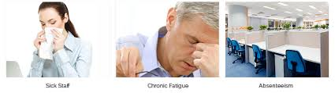
What is IAQ ???
The physical, chemical, and biological properties of air within and around buildings that can affect the comfort or health of the occupants.
Most people benchmark IAQ w.r.t. temperature, humidity & fresh air.
Indoor Air can be contaminated by VOC’s, Microbial organisms & Airborne Pathogens (TB, H1N1, SARS) that can adversely affect the health of people.
Poor IAQ can cause “SBS” where individuals report symptoms such as headaches, fatigue, drowsiness, and eye, nose, and throat irritation resulting in a loss of productivity.
Fatigue
Respiratory Infection
Absenteeism

Slide 6



Are You Health Conscious ???
Solid Consumption
Solid Consumption = 1Kg/Day
Liquid Consumption = 3Ltrs/Day
Air Consumption = 11000 Ltrs/Day
(7-8 ltr X 60min X 24hrs)

Slide 7
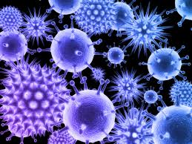
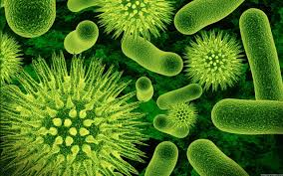
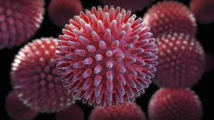
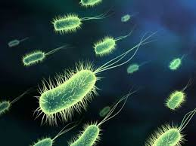
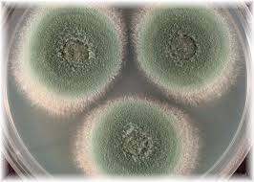
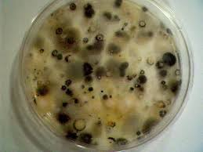
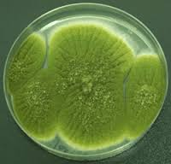
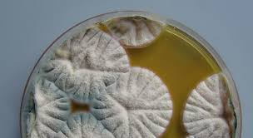
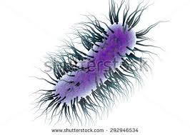
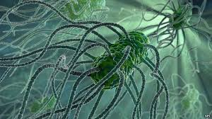

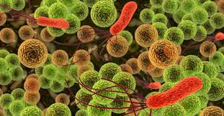
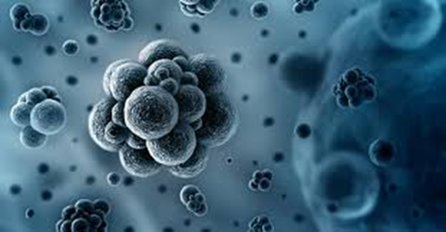


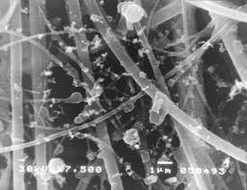
Do you know what you’re breathing ?
VIRUS
MOLD
BACTERIA
VOC’s & PARTICULATES

Slide 8
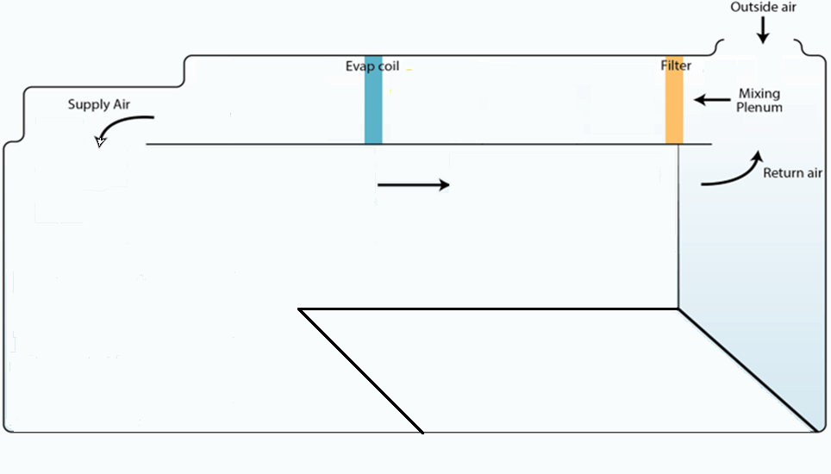



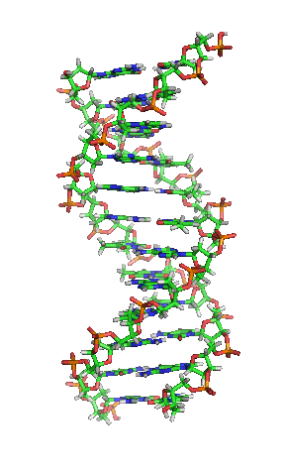













IAQ in an Office Building.
Outdoor Pollution
Micro-organisms
mold
Outdoor Pollution
Dust
Occupants
Spores
VOC’s
Bacteria
VOC
Pathogens
Virus
Bacteria
Mold & Bacteria
VOC
Particulates
Dust & Particulates

Slide 9
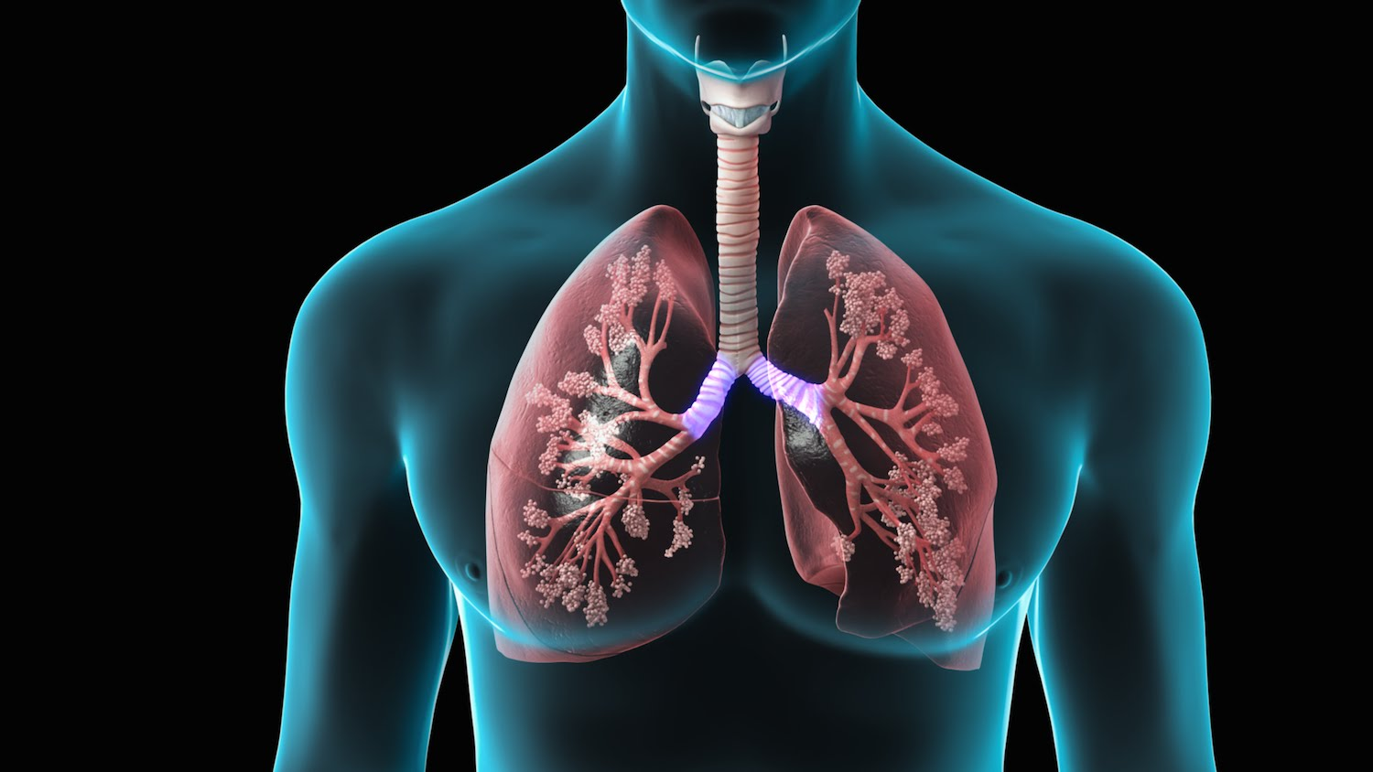

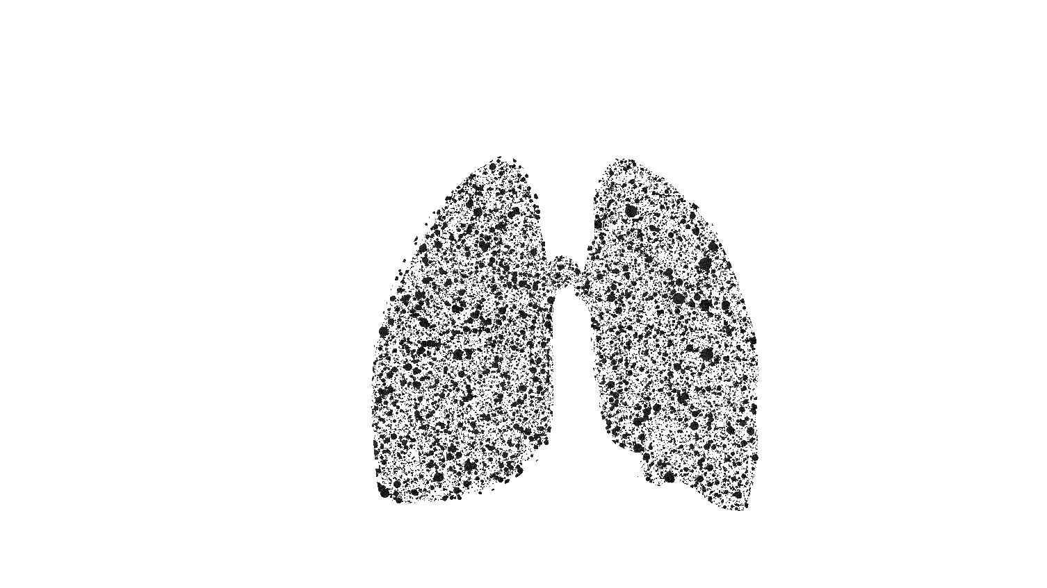


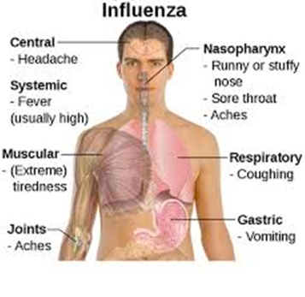
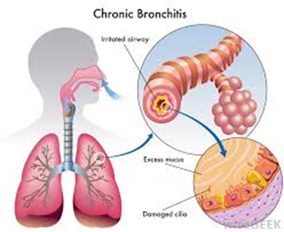
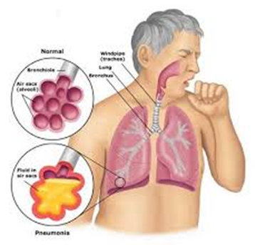
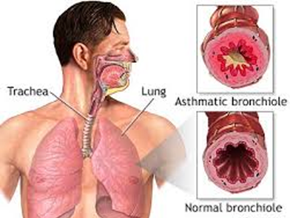
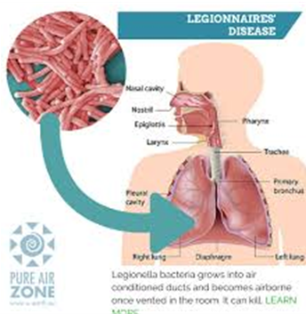
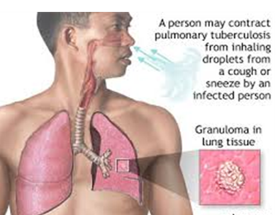
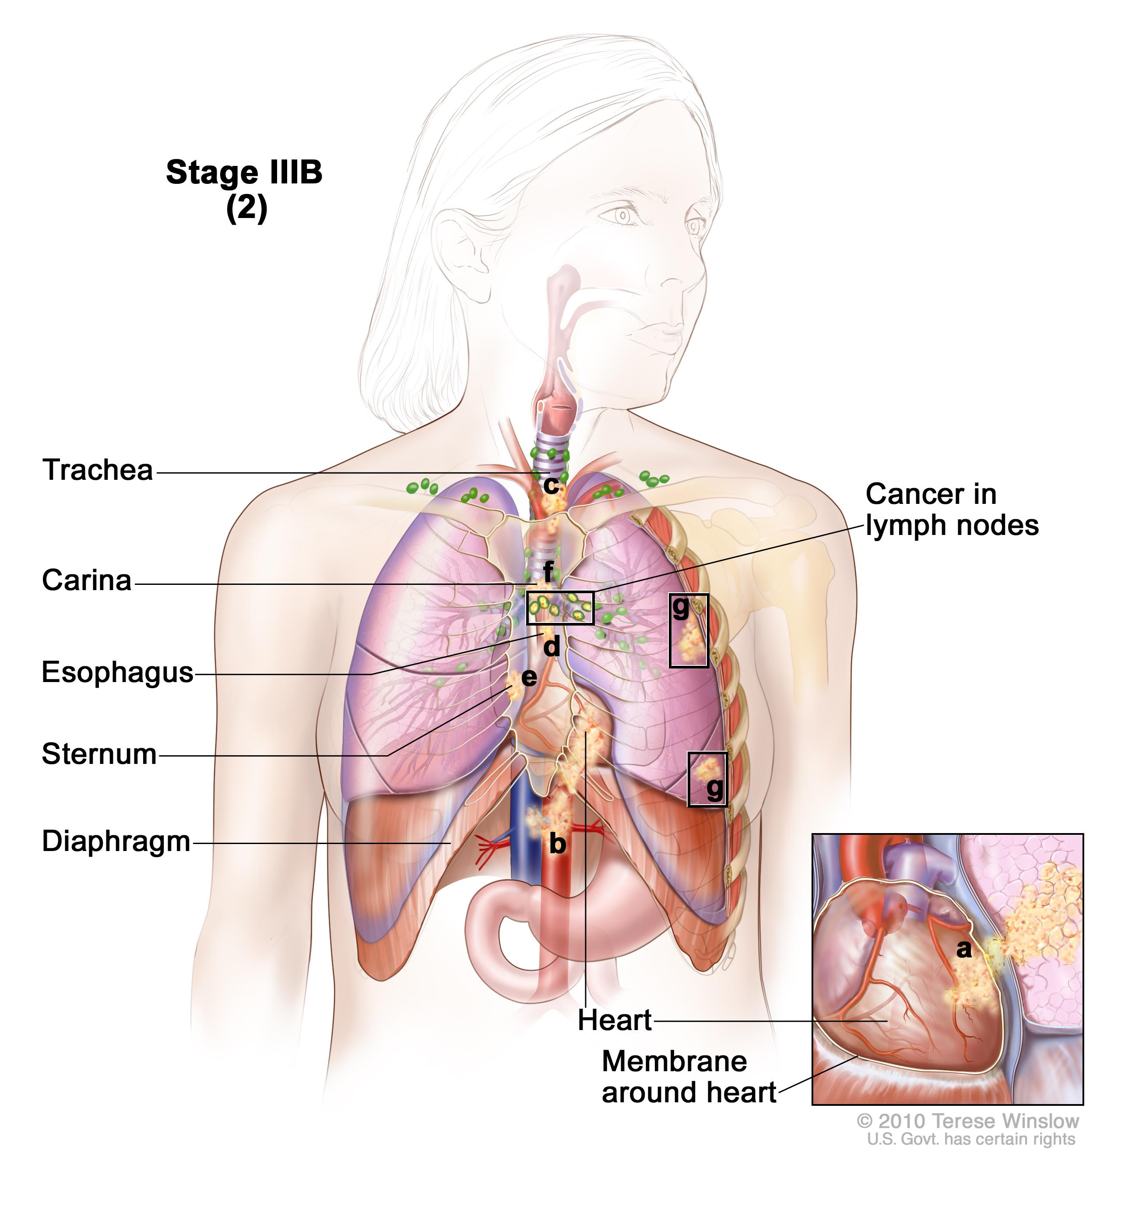
Influenza
Bronchitis
Pneumonia
Asthma
Legionnaire's Disease
Tuberculosis
Cancer
RESPIRATORY SYSTEM

Slide 10
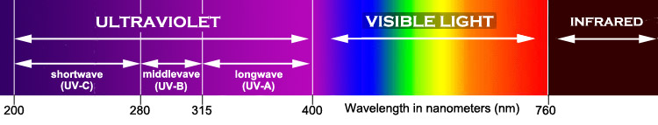
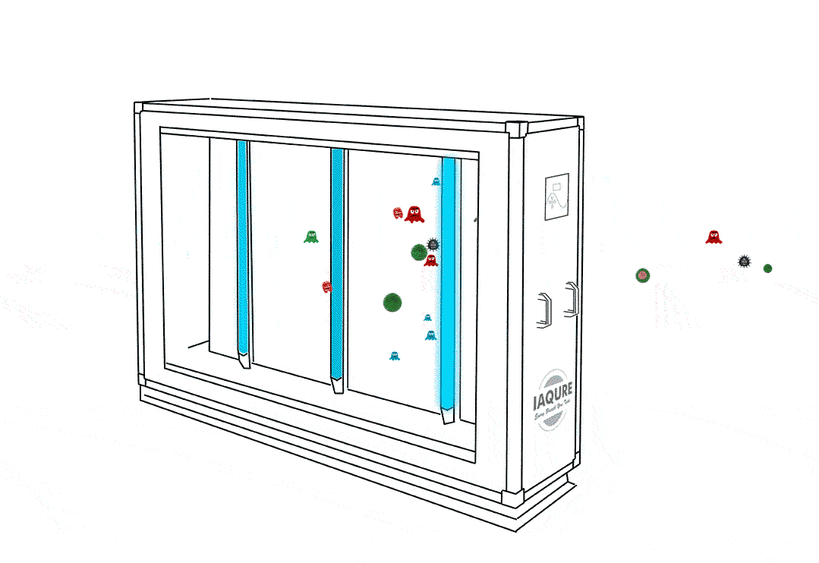
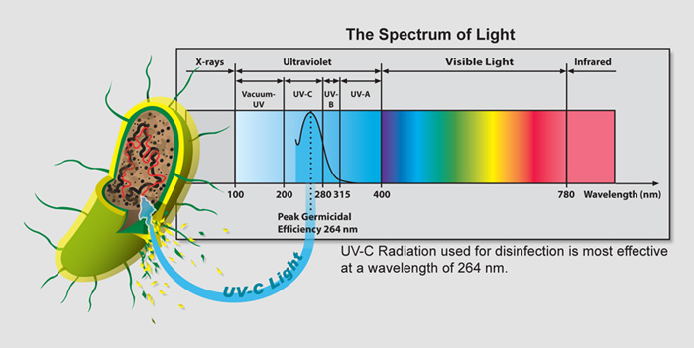
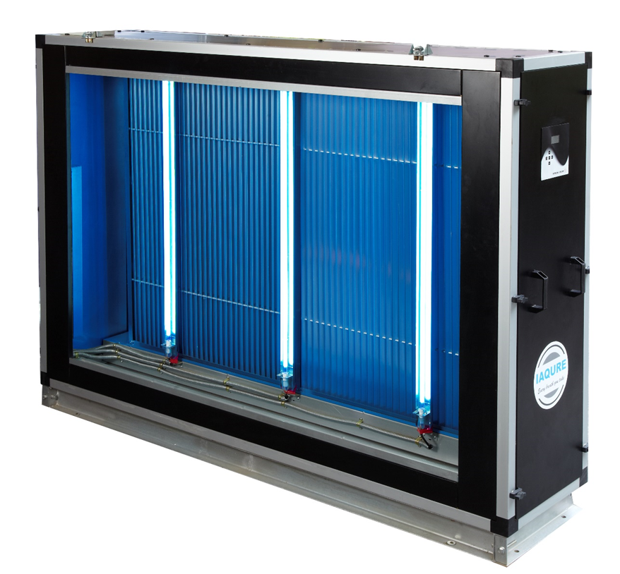
UVGI Technology

Slide 11
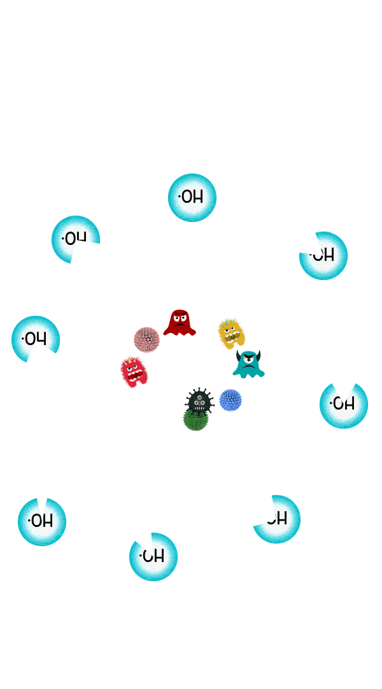
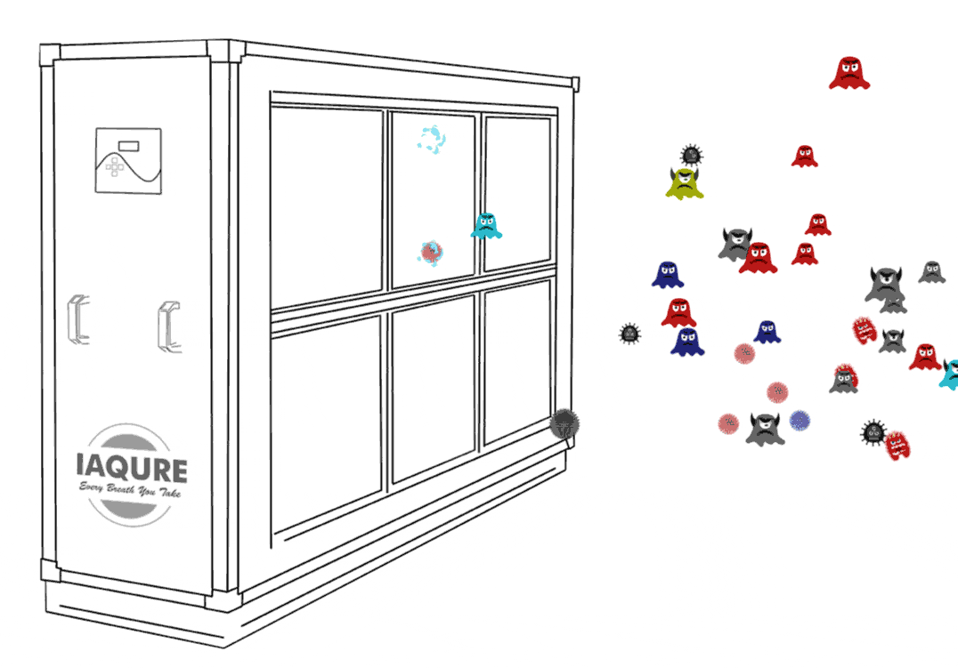
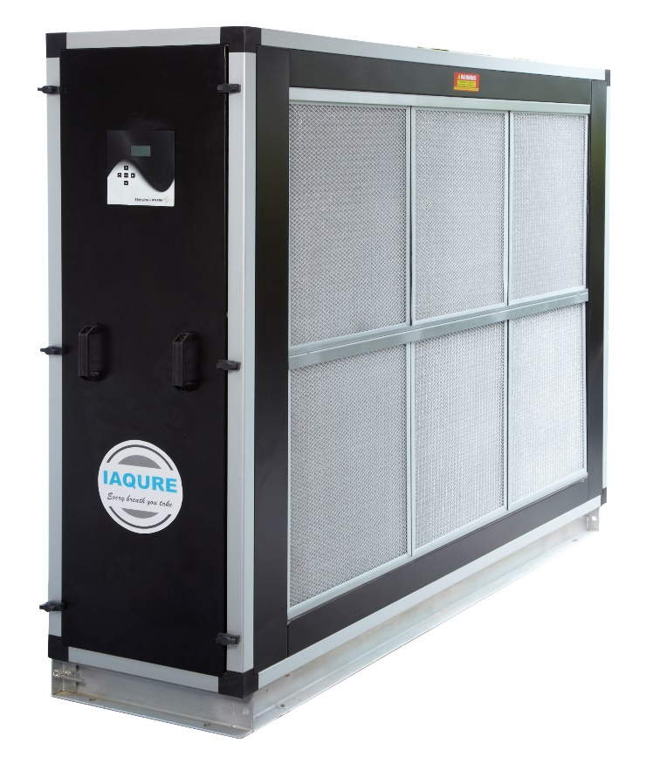


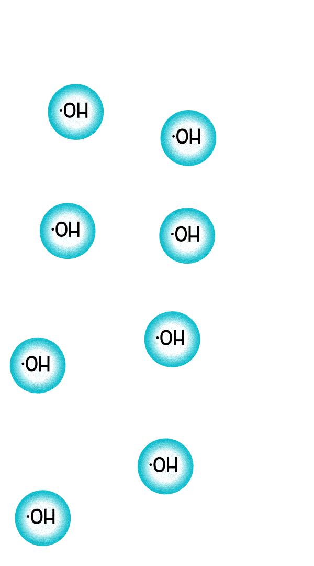

Photocatalytic Oxidation Process
Ultra
Violet
Emitters
Photo Catalytic
Reactor
Hydroxyl
Radicals
Released
Destruction
of VOC’s & Micro-organisms

Slide 12

IAQURE – System Schematic Diagram
AHU
UV-C Emitter
Air Decontamination
Purified Air Into System
Surface Decontamination
UV-C activates Reactor
Contaminated
Air In
Cooling Coil
Photocatalytic Reactor (TiO2)
PCO ensures No by-pass of Contaminated Air
Primary Air Filter
Notes:
3 min

Slide 13
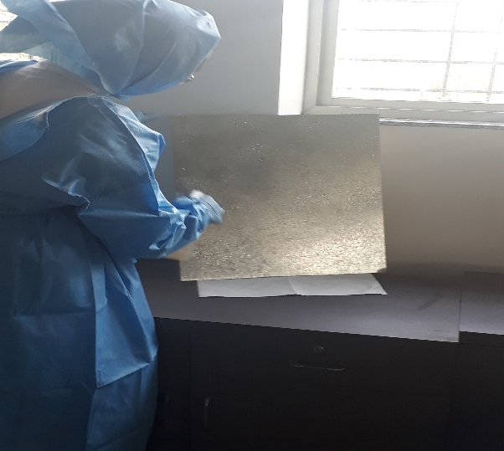
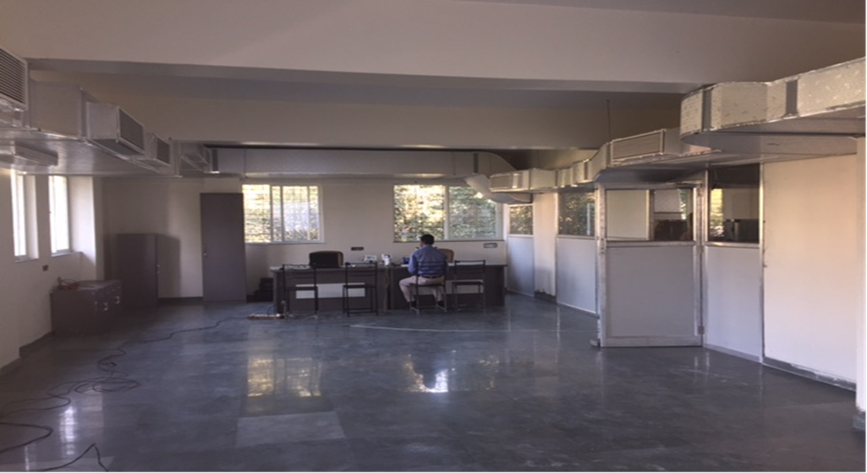
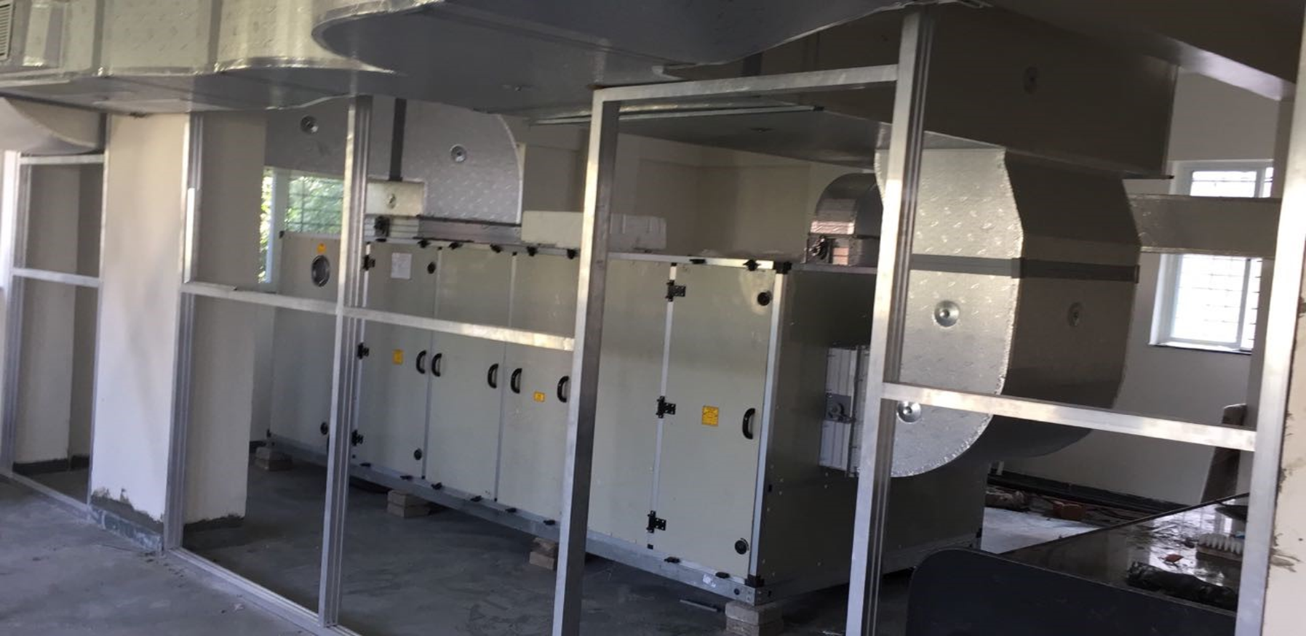
System Efficacy - Microbial De-Contamination
NABL Certified Agency appointed to test and validate the efficacy of the system.
Testing facility - 2000 Square Ft. Sterilized room with ducted supply and return air.
Temperature was maintained @ 23 deg C and 50% Rh to simulate a commercial building environment.
2 Test plates, one coated with Nano TiO₂ and another without were infected with a consortium of micro-organisms and place inside the AHU.
Spraying of Microorganism
Collection & Culture Media

Slide 14
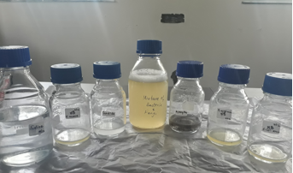
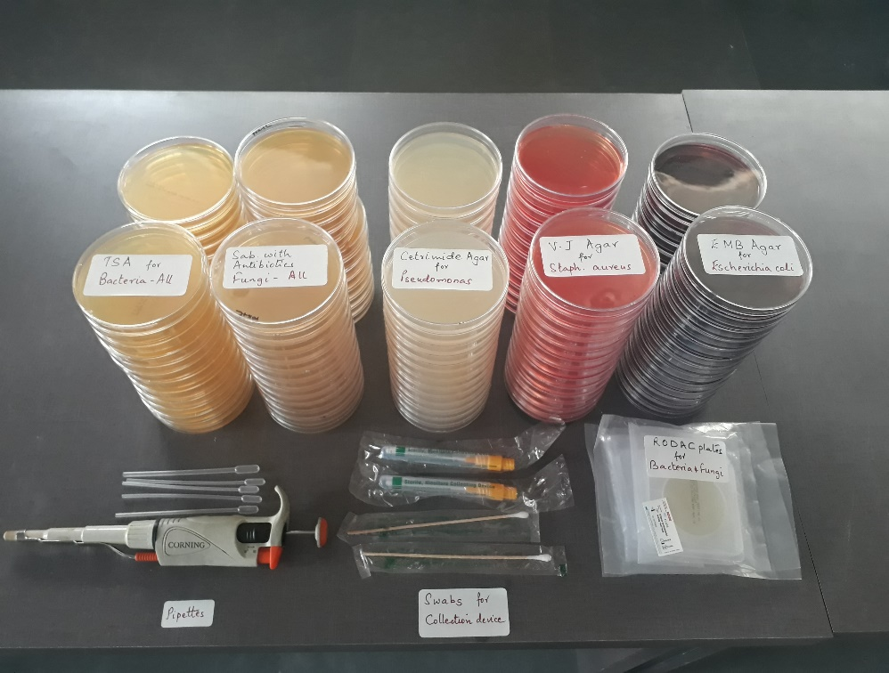
System Efficacy - Microbial De-Contamination
Sl. No | Micro-Organisms | Category | Culture Media
1 | Staphylococcus aureus | Gram Positive Bacteria | Vojel Johnson (V J) agar
2 | Escherichia coli | Gram Negative Bacteria | Eosin Methylene Blue (EMB) agar
3 | Pseudomonas aeruginosa | Gram Negative Bacteria | Cetrimide agar
4 | Candida albicans | Yeast | Sabourauds Dextrose agar with Antibiotic
5 | Aspergillus niger | Mold

Slide 15
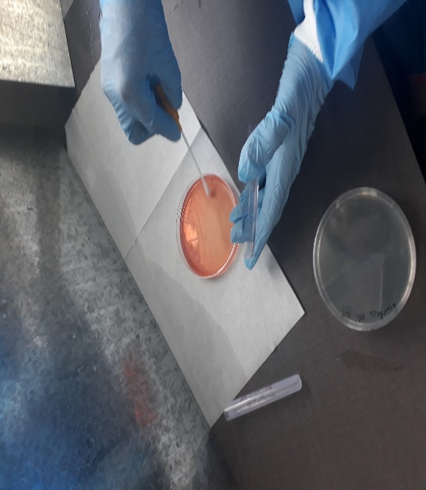
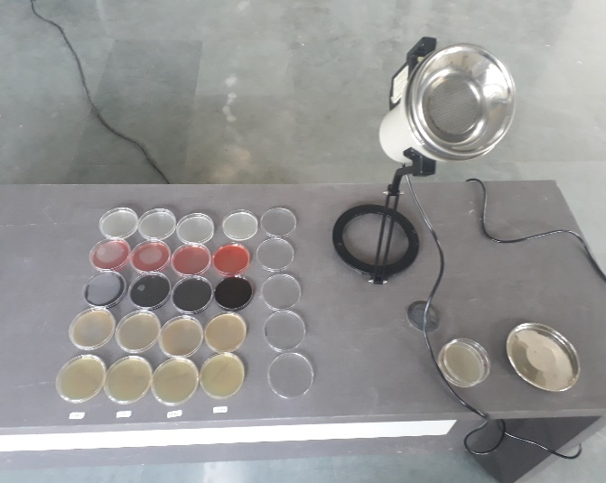
Methodology - Microbial De-Contamination
Swab samples from treated and untreated plates are collected and spread over different Culture media (agar plates) to capture specific micro-organism count.
To monitor the reduction in CFU in air, samples are collected with an Anderson sampler and Gravimetric method.
The samples are collected at interval of 0 hour to get initial count and further samples are collected after 15 minutes and 180 minutes.

Slide 16
Microbial Surface and Air Sampling Analysis
Sampling Type | Surface Sampling |  |  |  |  | Air Sampling
 | Test Plate Exposure Time |  |  |  |  | Gravimetric (Manual) |  |  | Anderson Machine
Micro-organism | 0 Mins | 15 Mins |  | 180 Mins |  | 15 Mins |  | 180 Mins | 15 Mins | 180 Mins
 | Microbial Count in CFU | Only UVGI | UVGI + PCO | Only UVGI | UVGI + PCO | At Supply Grill |  |  | At Centre of Room
Staphylococcus aureus | >100000 | 21 | 0 | 0 | 0 | 0 | 0 | 0 | NA
E. coli | >100000 | 9 | 0 | 0 | 0 | 12 | 0 | 0 | NA
Pseudomonas aeruginosa | >100000 | 180 | 0 | 0 | 0 | 8 | 0 | 0 | NA
Candida Albicans | >100000 | 20 | 0 | 12 | 0 | 22 | 0 | 0 | 34 | 0
Aspergillus Niger | >100000 | 8 | 0 | 3 | 0 | 3 | 0 | 0 | 14 | 0

Slide 17
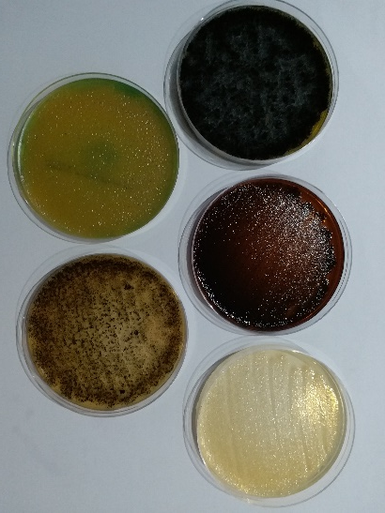
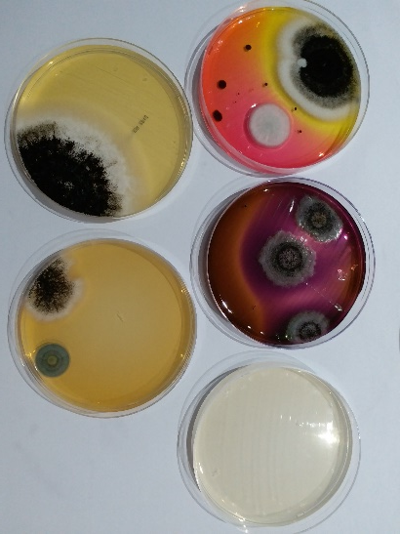
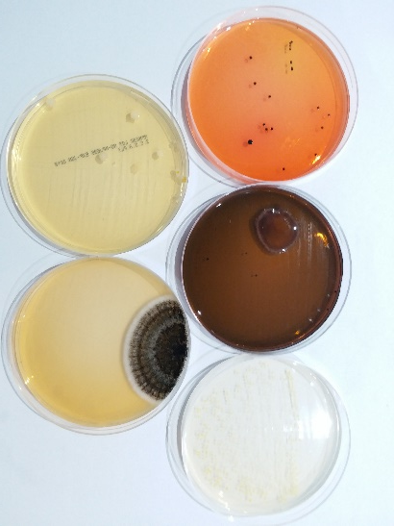
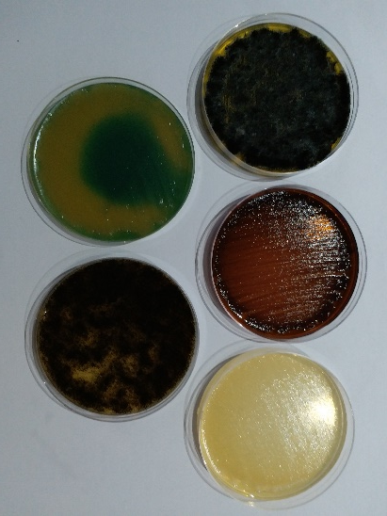
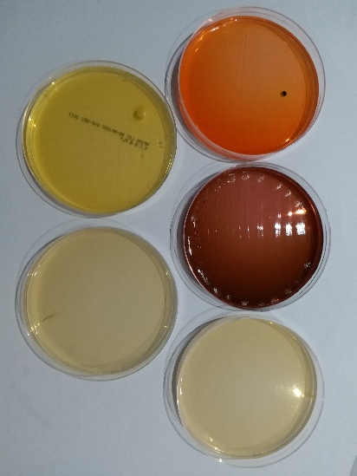
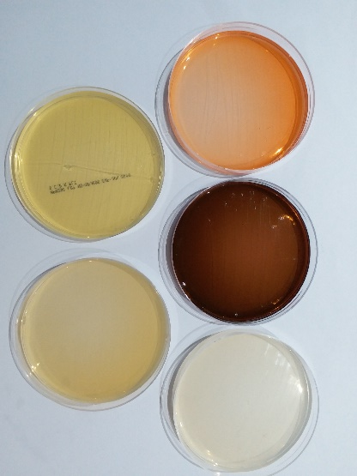
Microbial Analysis – Surface Sampling.
Only UVGI
UVGI + PCO
0 min
100,000 TCFU
15 min
231 TCFU
180 min
15 TCFU
0 min
100,000 TCFU
15 min
0 CFU
180 min
0 CFU

Slide 18
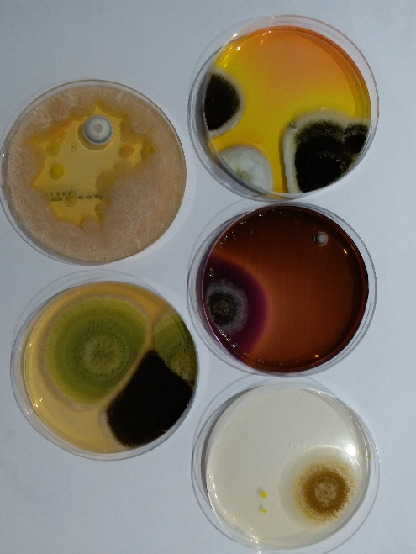
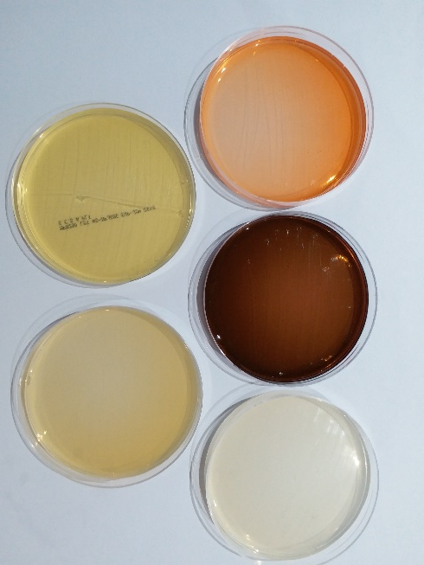
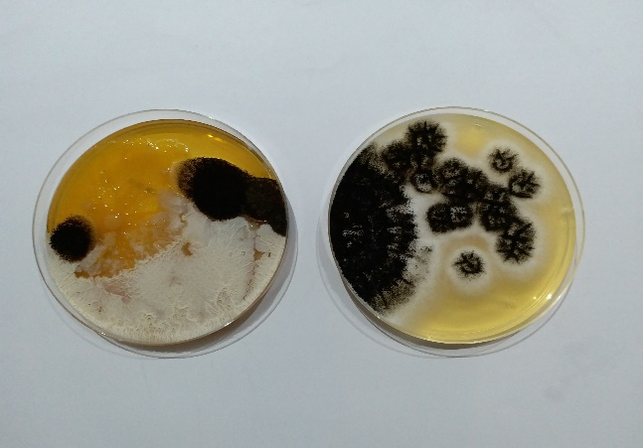
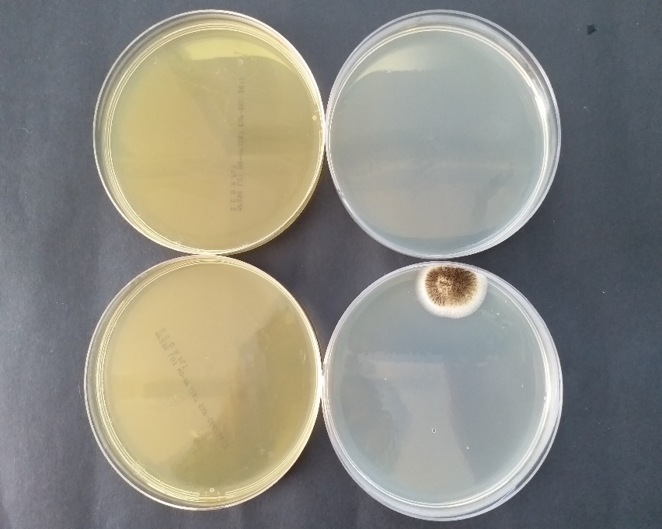
Microbial Analysis – Air Sampling.
By Gravimetric Method
By Anderson Air Sampler
15 min
45 TCFU
180 min
0 TCFU
15 min
45 TCFU
180 min
0 CFU
IGBC parameter for Indoor Emission & Microbial Count | Threshold value Class A | Threshold value Class B
Total Microbial Count | 50 CFU/m³ | 150 CFU/m³

Slide 19

Methodology - Efficacy of PCO for VOC Reduction
A mixture of Paint thinner, Cleaning Chemicals, Sanitary Deodorizer & Aerosols (Room freshener) were introduced into the air conditioned space, simulating TVOC counts above Toxic Limits.
The Graywolf Sensors were setup for monitoring.
Upon stabilization of TVOC reading, the data logger is started to record the TVOC count and monitor TVOC reduction with the IAQURE system in real time.
Logging was stopped when the VOC count reached the permissible count of 500 µgm/m³
The process was repeated for the same timeframe without the PCO to determine the TVOC reduction and determine the efficacy of the system.

Slide 20
Methodology - Efficacy of PCO for VOC Reduction

Slide 21
























IAQURE Installation Base (SP Info City)

Slide 22


Proof of Concept – Live Testing

Slide 23
Proof of Concept – Live Testing
Benchmark with IGBC – Healthy Building Standards for Micro-organism and TVOC control.
Customer | Microbial Count (CFU) Sample Surface Area 25 Sq. cm² |  |  | Microbial Count (CFU/m³) Air Sampling |  | TVOC (µg/m³)
 | Pre Installation Oct 2017 | Post Installation Dec 2017 | Post Installation Mar 2018 | Post Installation Mar 2018 | IGBC Class | Post Installation Dec 2017 | Post Installation Mar 2018 | IGBC Class
Customer 1 | 1000++ | 0 | 8 | 77 | B | 60 | 122 | A
Customer 2 | 1000++ | 1 | 20 | 48 | A | 357 | 157 | A
Customer 3 | 1000++ | 56 | 4 | 34 | A | 75 | 125 | A
Customer 4 | 1000++ | 55 | 4 | 28 | A | 89 | 147 | A
Customer 5 | 1000++ | 2 | 10 | 127 | B | 201 | 140 | A
IGBC Threshold values for Microbial Count & VOC : 50 CFU/m³ & 500 µg/m³ for “ Class A “ 150 CFU/m³ & 650 µg/m³ for “ Class B” respectively , as per IGBC standard .

Slide 24






The IAQURE Advantage
Certified by CII – Green Products & Services Council
UL Certified UVGI System
Increased Productivity & Lower Absenteeism
Improved Heat Transfer – Power Savings
Enhanced Coil Life – Lower Maintenance Costs
World Class Indoor Air Quality

Slide 25

Thank You
seanmenezes@sterlingwilson.com
Cell: +91 98922 88888

Slide 26
IGBC Healthy Building Rating
“Healthy Building”
Rating
Indoor Air Quality
10
Water Quality
6
Comfort
35
Health & Sanitation
4
Fitness & Nutrition
10
Wellbeing – Emotional & Intellect
20
Social Wellbeing
10
Innovation & Design
5
Certified Level | Credits | Recognition
Certified | 50 – 59 | Best Practices
Silver | 60 – 69 | Outstanding Performance
Gold | 70 – 79 | National Excellence
Platinum | 80 – 100 | Global Leadership
Credit | Parameter | Points
IAQ Credit -1 | Monitor Indoor Air Quality | 7
IAQ Credit -2 | Reduce Indoor Emissions | 3
ID Credit | Innovation & Design | 1
 | TOTAL | 11

Slide 27
IGBC Healthy Building Standards
Parameter for Monitoring | Threshold values |  |  | Frequency of Monitoring
 | Class A | Class B | Class C
CO₂ | Max 350 ppm above ambient | Max 440 ppm above ambient | Max 530 ppm above ambient | Daily Monitoring
PM 2.5 | < 15 µg/m³ | < 20 µg/m³ | < 25 µg/m³
PM 10 | < 50 µg/m³ | < 75 µg/m³ | < 100 µg/m³
CO | < 2 ppm | < 6 ppm | < 9 ppm
O₃ | < 50 µg/m³ | < 75 µg/m³ | < 100 µg/m³
TVOC | < 500 µg/m³ | < 650 µg/m³ | < 800 µg/m³ | Quarterly Monitoring
SO₂ | < 40 µg/m³ | < 80 µg/m³ | -
NO₂ | < 40 µg/m³ | < 80 µg/m³ | -
Parameter for Indoor Emission & Microbial Count | Threshold value Class A | Threshold value Class B | Frequency of Monitoring
CH₂O | < 40 µg/m³ | < 100 µg/m³ | Quarterly Monitoring
Total Microbial Count | 50 CFU/m³ | 150 CFU/m³

